Slide 1
Lesson 02
  Structure, composition and bonds

Slide 2
Hair types

Slide 3
What makes up a hair type?
Shape
Hair can vary from poker straight to tight curls.
Straighter hair typically has a rounder cross section.
Curly hair, on the other hand, has a flatter,
more oval shape.
Diameter
Across all hair types, the diameter of fine hair can
be as small as 40 micrometers, with coarse hair
being around 120 micrometers.
Volume
Volume is determined by the thickness of hair and
the number of hairs a person has. A high number
of finer hairs or a lower number of thicker hairs,
will have the same overall effect.

Slide 4
Hair composition
Protein
a-keratin is a long, fibrous protein made up
of amino acids that gives hair its shape and
structural properties. Keratin is also found
in nails and skin.
Fats and oils
4%
Water
17%
Water
Hair naturally contains ‘bound’ water.
The more humid an environment, the more
water there will be. When there’s an excess
of ‘free’ water, hair is considered wet.
Protein
79%
Fats and oils
These act as a glue to help hold the structure and
make hair water repellant. The amount produced
can be affected by factors such as climate changes
and how frequently hair is washed.

Slide 5
What is keratin?
a-keratin fibers are less than
2nm wide and 45nm long
Billions of proteins combine
to form a single strand of hair
Fibers combine to form
larger cortex cell structures
Fibers and structures are held together
by a matrix that acts like a glue
The shape of keratin is like a spring,
which allows hair to stretch slightly
When hair is stretched too far,
it changes permanently to β-keratin
Notes:
What is keratin?
— α-keratin fibers are less than 2 nanometerss (nm) wide and 45nm long.
— Billions of these proteins combine to form a single strand of hair.
— The fibers then combine to form larger cortex cell structures, each around 1–6 microns (µm) thick and 50–100µm long.
— The fibers and structures are held together by a matrix that acts like a glue, culminating in a strand of hair that is protected by the cuticle layer.
— The shape of keratin is similar to a spring, which allows hair to stretch slightly with minimal damage. When stretched too far, it changes permanently to β-keratin, which is weaker and less elastic, making the hair easier to break.

Slide 6
What gives keratin its shape?
Disulphide bonds
Salt bridges
Hydrogen bonds
Strong, permanent bonds that give hair its strength
Disrupted by very high temperatures and chemical treatments
Formed within keratin and connect the fibers together
Weak, temporary bonds that can be broken and reset
Can be broken during styling and chemical treatments
Can be broken by high pH levels, water and heat
Temporary bonds that are naturally weaker
Can be easily broken by water and/or heat
Can reset during styling, making it easier to style hair
Notes:
Disulphide bonds
— These are strong, permanent bonds that give hair most of its strength. They are only disrupted by very high temperatures and chemical treatments. These bonds form between the cysteine amino acids found within keratin and connect the fibers together to form protofibrils, the structure of the hair.
Salt Bridges
— These are weak, temporary bonds that can be broken and reset during styling. They can be broken by high pH, water and heat during styling, as well as chemical treatments.
Hydrogen bonds
— These are also temporary bonds but are naturally weaker than both the disulphide bonds and salt bridges. They can be easily broken by water and/or heat and reset during styling, making it easier to style hair temporarily.

Slide 7
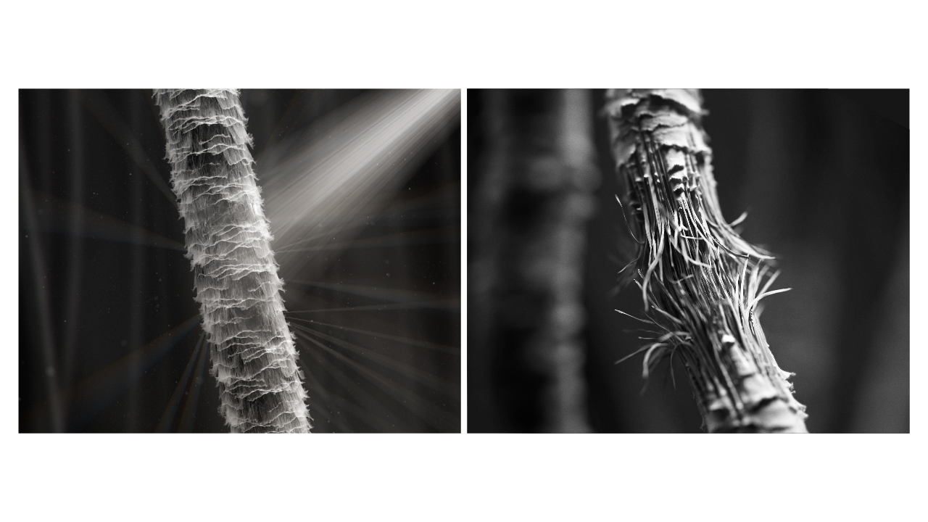
Hair fiber structure
Cuticle
Cortex
Notes:
Cuticle
— The outer layer of hair, known as the cuticle, is made up of overlapping transparent cells that protect hair from damage and reflect light to make the hair shiny.
— When first grown, cuticles lay flat and are tightly bound together.
— The cuticle doesn’t absorb water evenly which often distorts the hair, making it rough in texture and increasing strand friction.
— Water on the surface of the hair also causes strands to stick together weakly, increasing tangling and damage to the hair when brushed, combed or styled.
Cortex
— The center of the hair strand, known as the cortex, is made up of long, thin cortical cells containing α-keratin.
— These structures give hair its strength, elasticity and contain melanin pigments which give hair its colour.
— Within the cortex, water can cause hair to swell in diameter by an average of over 10%.
— This can cause breakages in the hydrogen bonds which hold the structure of hair together, weakening it by over 40%, subject to the hair type.
— This can make it easier to permanently damage hair, either by making it thinner or snapping the strands while brushing, combing or styling.

Slide 8
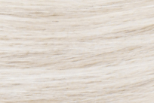
Hair color
Notes:
— Hair naturally has a slightly off-white color. The presence or absence of melanin granules dictate the final color of hair.
— An abundance of one type of melanin, called eumelanin, gives people black or brown colored hair.
— An abundance of another pigment, called pheomelanin, gives people red colored hair.
— The amount and type of melanin you have is determined by your genetics. This gene in humans is referred to as MC1R.
— This will provide instructions for making a protein called the melanocortin 1 receptor, which is involved in the pathway that produces melanin.
— Therefore, your hair color will be formed through the dominant gene you’ve inherited from your parents.
— Often, the brown hair genes dominates over blonde, red and other hair colors.

