Slide 1
Lesson 01
  Healthy hair

Slide 2
Do the images show
healthy or unhealthy hair?

Slide 3
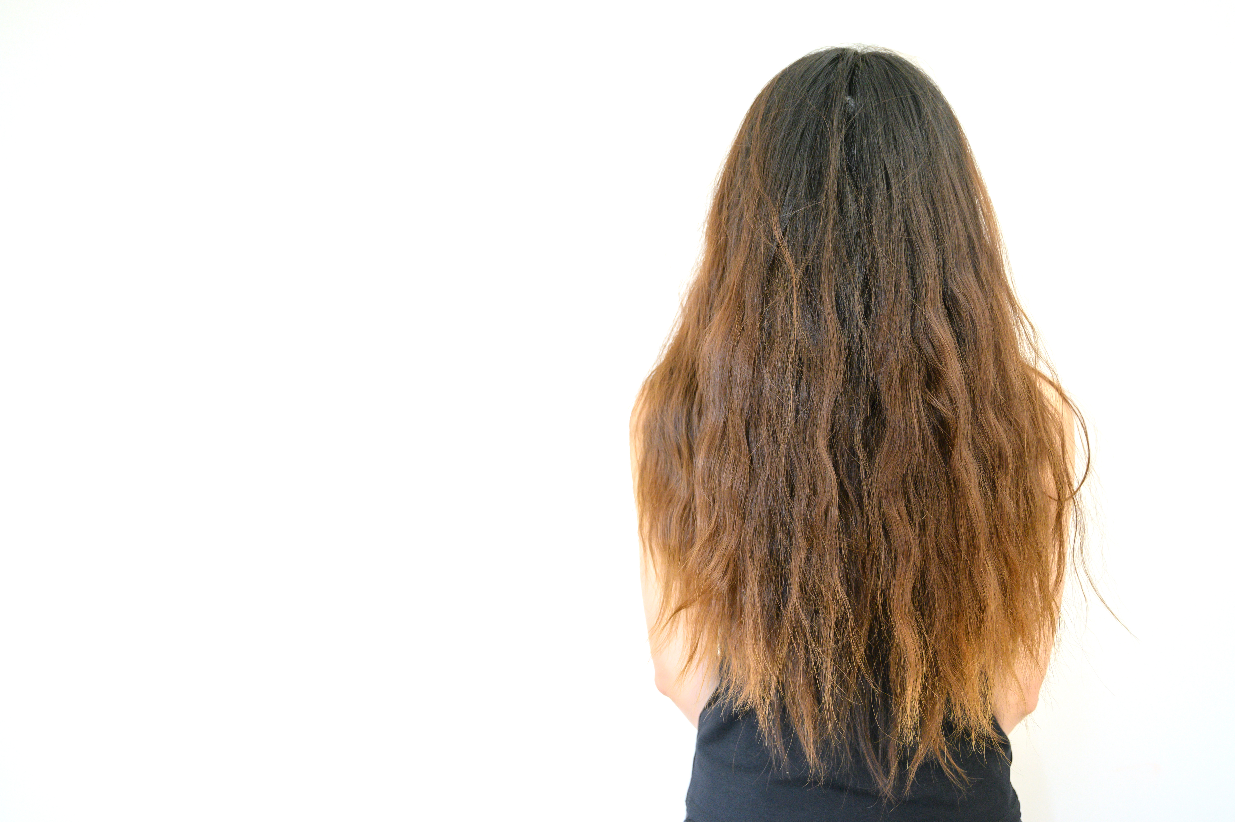
Notes:
50/50 – The hair is relatively healthy, as shown by the shine, but it does contain dye.

Slide 4
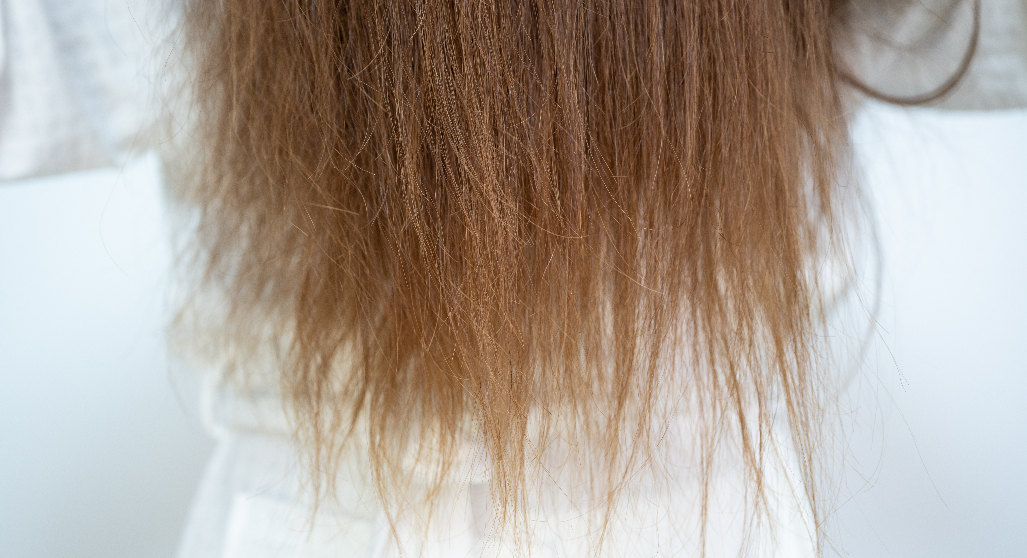
Notes:
Unhealthy – From excessive heat damage.

Slide 5
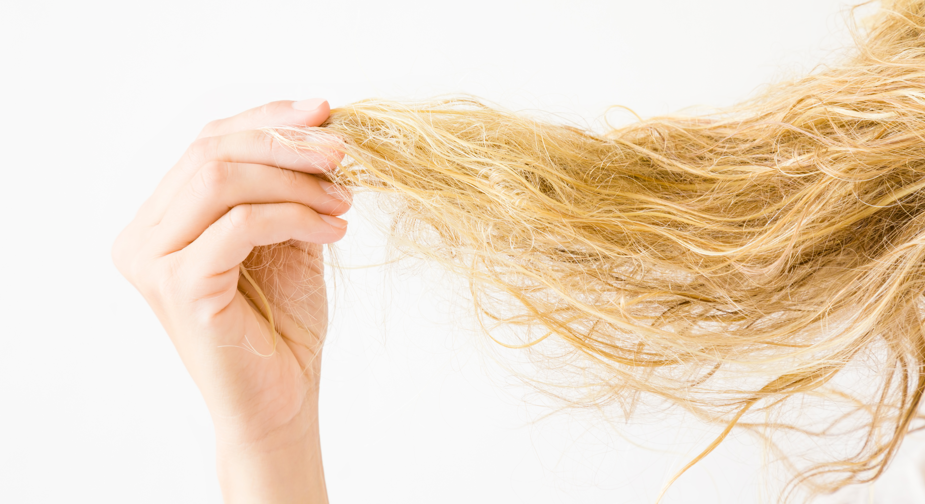
Notes:
Unhealthy – This hair is severely dry and damaged.

Slide 6
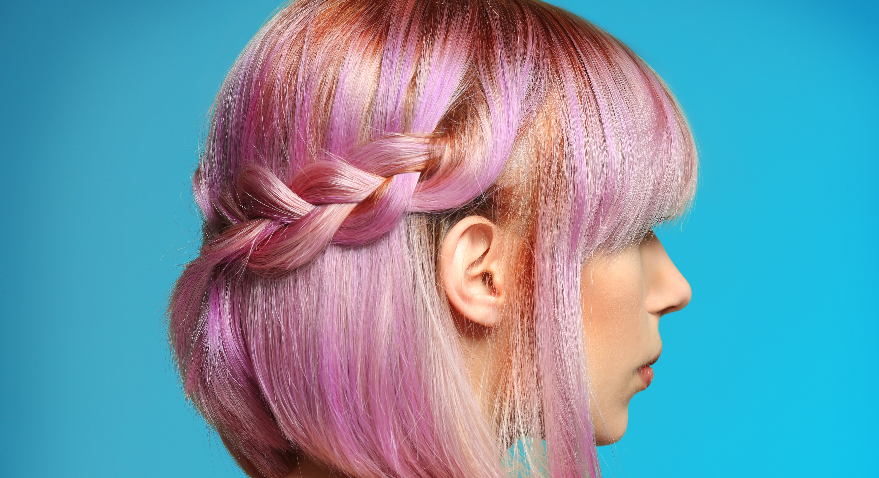
Notes:
Unhealthy – Due to excessive dye.

Slide 7
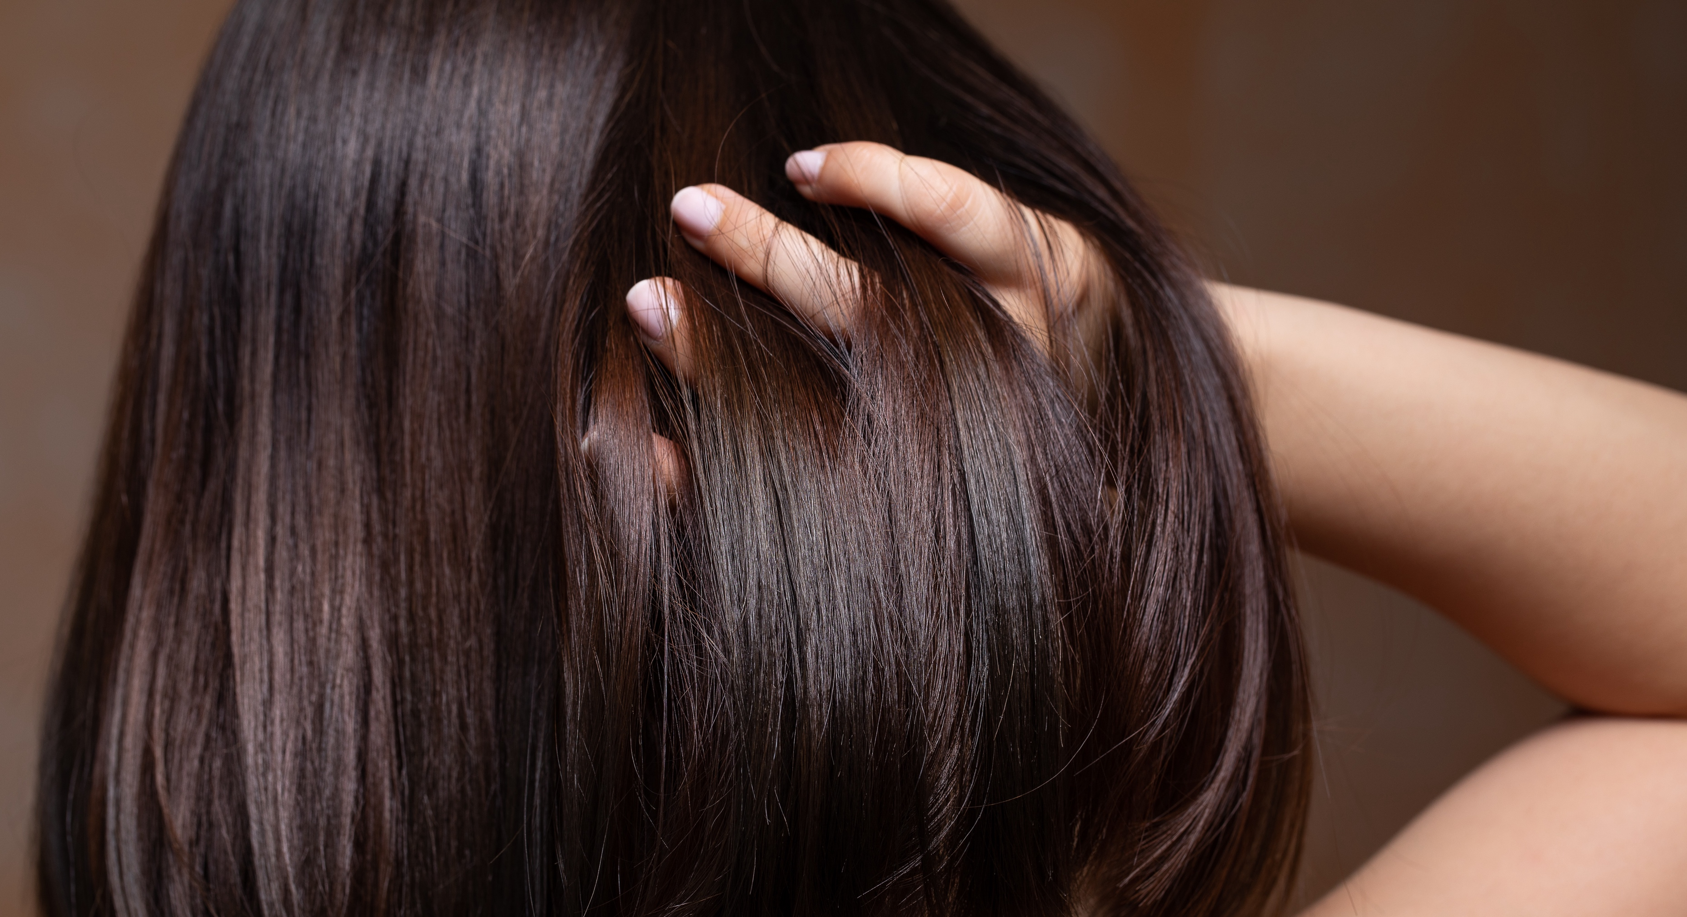
Notes:
Healthy – You can see this through the natural shine.

Slide 8
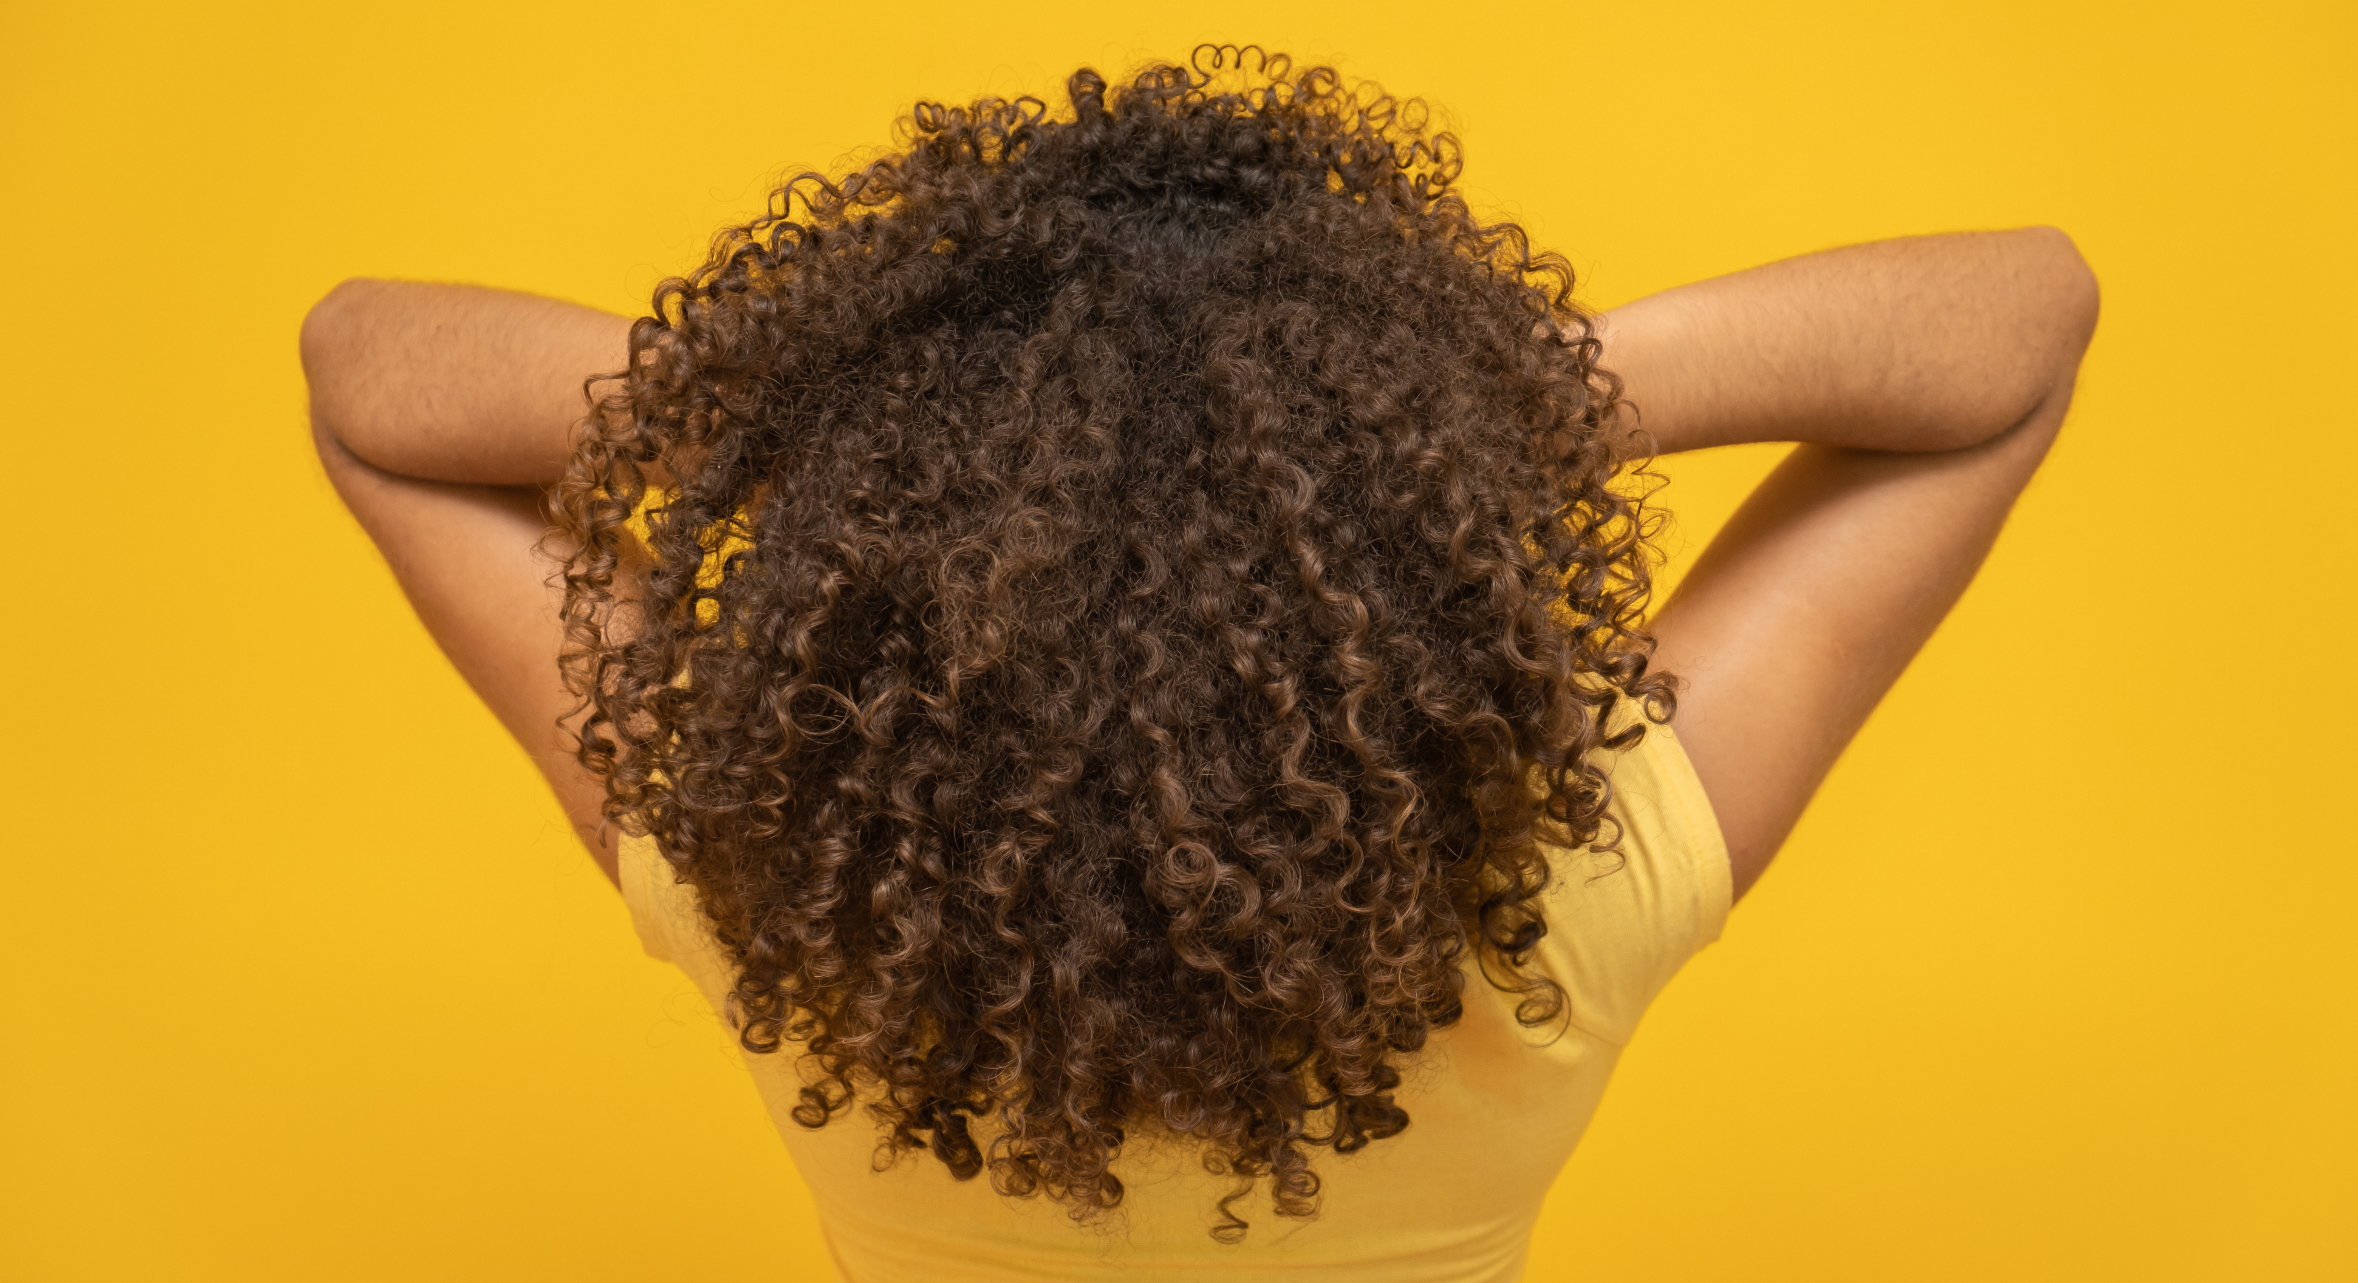
Notes:
Healthy – Well defined curls which have natural shine.

